Slide 1
Attendance and Enrollment
Dean Reich
Public School Finance
Notes:
Hello, it’s good to be here sharing about attendance and enrollment. My name is Dean Reich and I’m a part of School Finance within the State Department of Education. I encourage questions, if your question is better answered after this presentation I’ll encourage you to discuss it with me after.

Slide 2
Attendance and enrollment are important…
Well, how important are they?
About 90% of funding is based on enrollment and attendance data
Notes:
Attendance and enrollment are important. An inquisitive mind might ask, “Well, how important are they?” About 90 percent of current funding is based on the enrollment and the attendance data you submit. We don’t foresee this changing. My presentation will first focus on attendance – what it entails and how to review reports a day or two after uploads. Next, we’ll discuss enrollment in a similar manner. I’ll finish touching on a couple of other attendance and enrollment topics.

Slide 3
Attendance
Student under the guidance and direction of teacher engaged in teaching process
Measured in hours
  Meal periods, breaks, passing time, and recess are not to be included. (IDAPA 08.02.01.250)
  Less than 2.5 hours = zero (0) attendance value
  2.5 hours up to 4 hours = half (0.5) attendance value
  4 hours or more = full (1.0) attendance value
  Alternative and dually enrolled students have attendance reported in hours with no conversion to a 0, ½, or 1.0 value
Notes:
Attendance occurs when students are under the guidance and direction of a teacher who is engaged in the teaching process. This could be occurring in-person or virtually. Attendance is measured in hours that exclude meal periods, breaks, passing time, and recess. The hours for each student each day are converted to a daily attendance value. Less than 2 ½ hours = 0, 2 ½ hours up to 4 = ½, and 4 hours or more = 1 attendance value. Also note: attendance for alternative and dually enrolled students are simply reported in hours with no conversion to a 0, ½, or 1.0 attendance value.

Slide 4
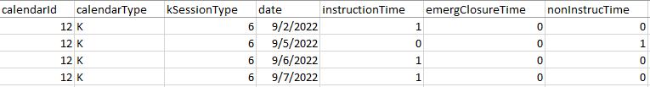
Attendance and Calendars
Your Student Information System (SIS) produces the data files the Idaho System for Educational Excellence (ISEE) requires, one of the files specific to attendance is:
  DistrictCalendar – “ISEE calendar”
  To maximize funding a different calendar is needed each time days in session vary
Notes:
Your Student Information System (SIS) produces the data files the Idaho System for Educational Excellence (ISEE) requires, one of the files specific to attendance it produces is and Excel file called DistrictCalendar. When we use the term “ISEE calendar” this is what we’re talking about. A snip of it is shown here. It identifies several categories of data like the days within each calendar type and also the instructional, emergency closure, and non-instructional time for each day. To maximize funding a different calendar is needed each time days in session vary.
Most LEAs have a need for multiple calendars within the kindergarten, elementary, or secondary grade groupings so they are set up to be “tracked”. Send me an email if you are concerned that you might need to be “tracked”. Later in this presentation I’ll point out how you can for sure know whether or not your LEA is tracked.

Slide 5
Attendance and Calendars
  Calendar Types
    K = kindergarten (time in 0, ½, or 1)
    R = regular school, includes JDC (time in 0, ½, or 1)
    SR = summer JDC (time in 0, ½, or 1)
    A = alternative school (time in hours)
    DR = students coming for a class or two (time in hours)
    SA = summer alternative school, approval required (time in hours)
Notes:
Each calendar is identified as one of 6 types. These types are: K, R, SR, A, DR, and SA. Kindergarten, regular, and summer JDC have time reported in 0, ½, or 1. These are related to the daily attendance values mention earlier. Alternative, DR, and summer alternative students have time reported in hours.

Slide 6
Attendance and Calendars
  Review the Enrollment Building Level report after each ISEE upload to ensure your calendar data is coming through correctly.
  Go to: https://boardofed.idaho.gov/k-12-education/isee-idaho-system-for-educational-excellence/
  Click, then log into the Education Application Portal
Notes:
School Finance encourages you to have someone review the Enrollment Building Level report 1-2 days after each ISEE upload to ensure your calendar data is coming through correctly. To get to this report, go to the Board of Education website and click on the Education Application Portal button to log in.

Slide 7
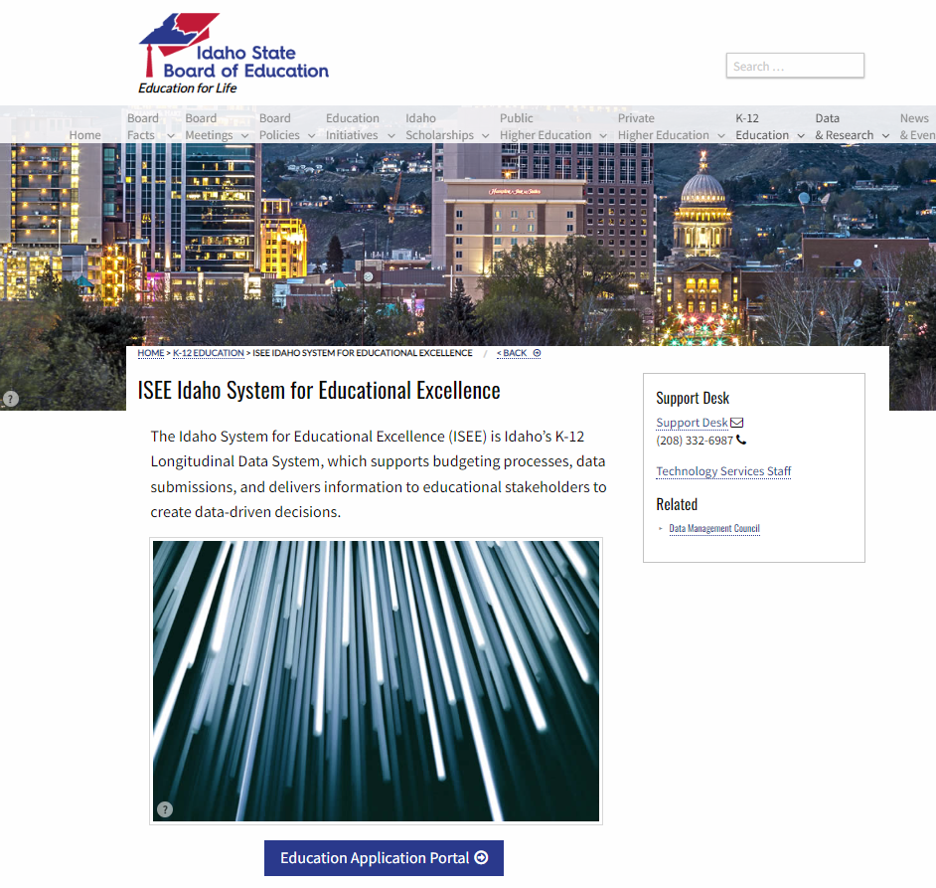
Attendance and Calendars
Notes:
Here you see the Board of Ed website and that button at the bottom.

Slide 8
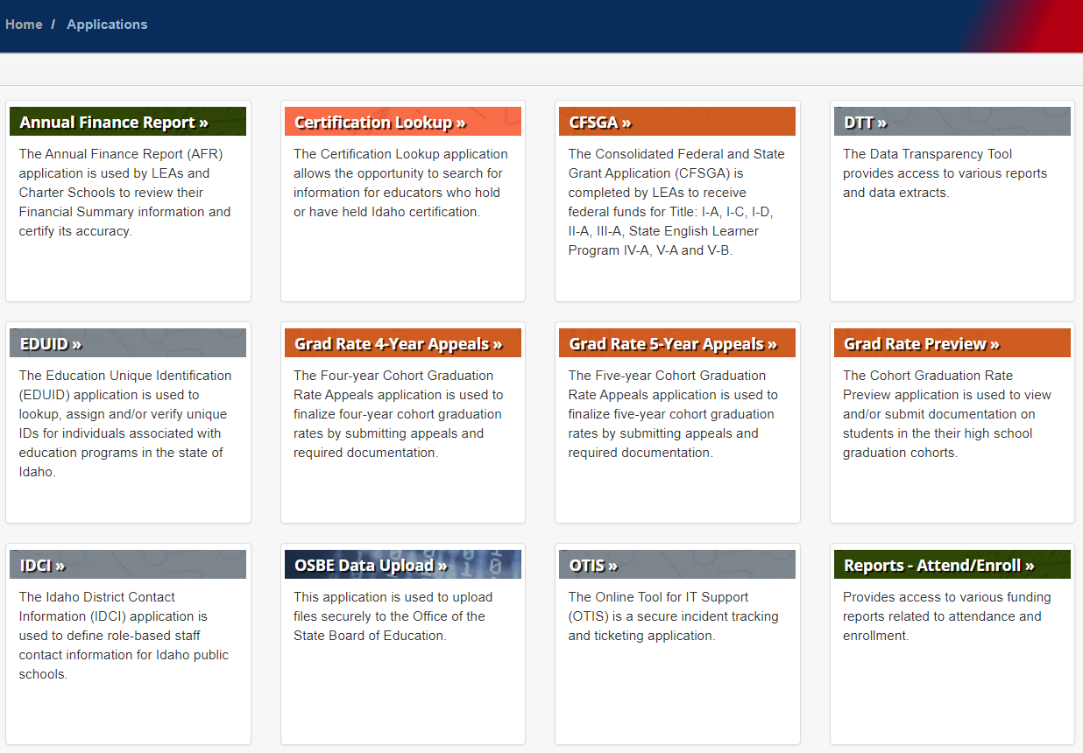
Attendance and Calendars
↑
Click
Notes:
Next, click on the Report – Attend/Enroll button shown here.

Slide 9
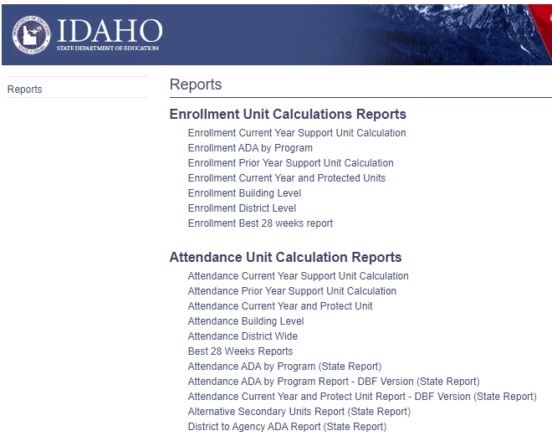
Attendance and Calendars
Notes:
From the various reports, choose the one titled Enrollment Building Level.

Slide 10
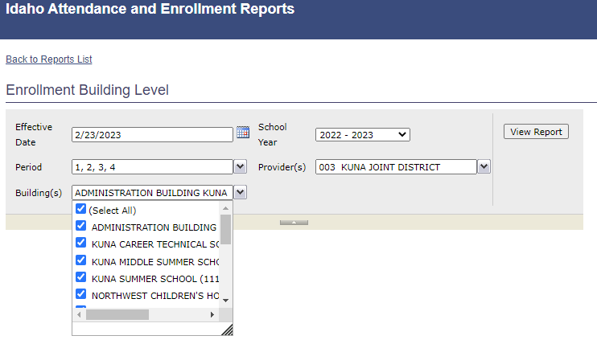
Attendance and Calendars
Notes:
You’ll need to select an effective date, school year, period, provider, and buildings like is shown.

Slide 11
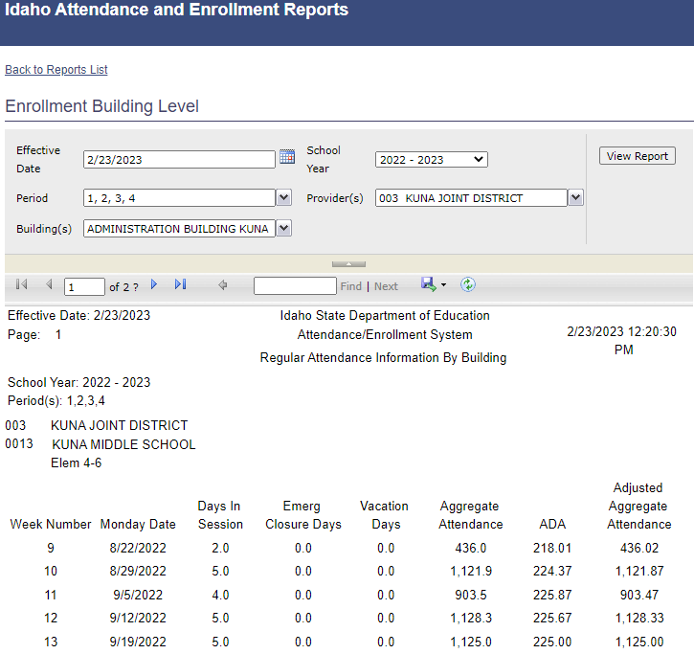
Attendance and Calendars
Notes:
Click here to export the report either as an Excel or PDF document. This makes the viewing of this multipage report easier.

Slide 12
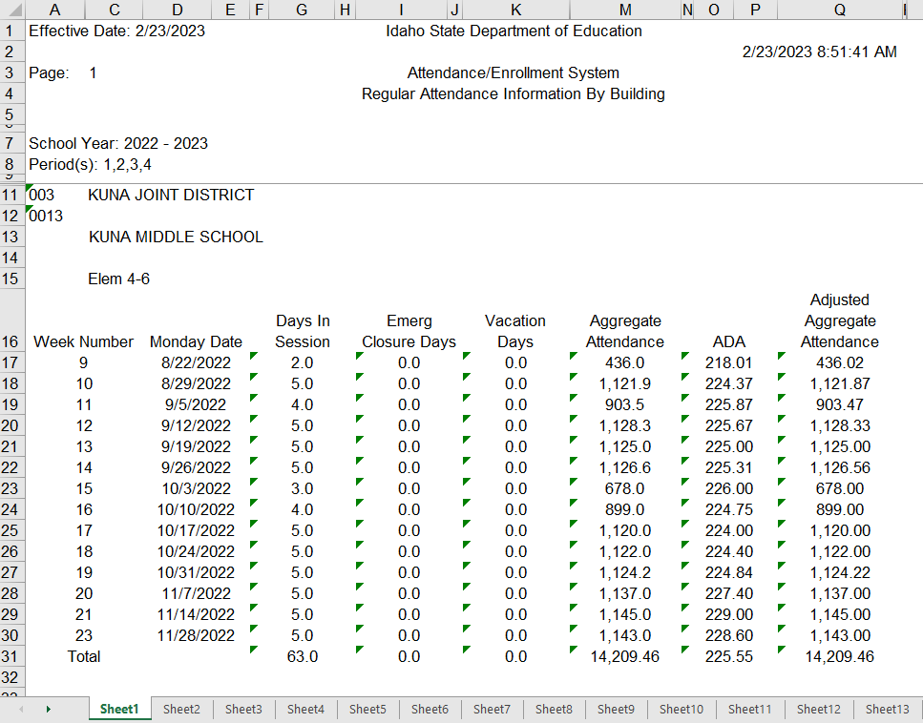
Attendance and Calendars
Notes:
This is how the report looks exported to Excel. Each sheet reports a different grade grouping within a building. The bigger the you are, likely the more sheets you’ll see. Make sure the “Days in Session” column is a match to what you know they should be. If you find errors, like the week beginning 8/22 should have had 3 days. You’ll need to correct it in your SIS. Then, repeat the complete upload process.

Slide 13
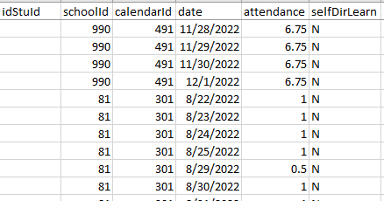
Student Daily Attendance
Your SIS also produces another data file specific to attendance called:
  StudentDailyAttendance – This Excel file holds the attendance value (0, ½, 1, or hours) for every student every day.
  This file is difficult to review, so please review a report called Aggregate Attendance Detail
Notes:
Your SIS also produces another data file specific to attendance called StudentDailyAttendance. This Excel file holds all of the attendance values, the 0, ½, 1, or hours, for every student every day like we see highlighted here. This file is difficult to review, so instead have the Aggregate Attendance Detail report reviewed.

Slide 14
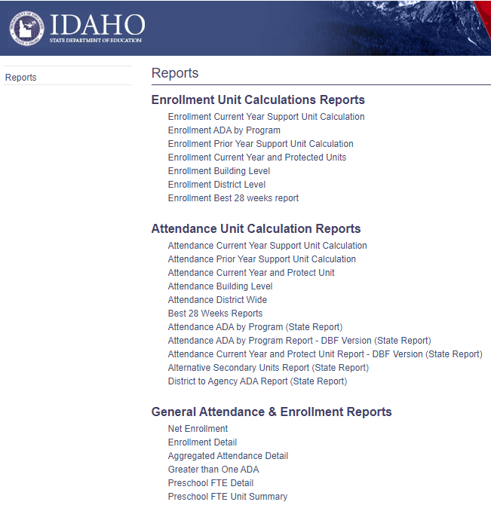
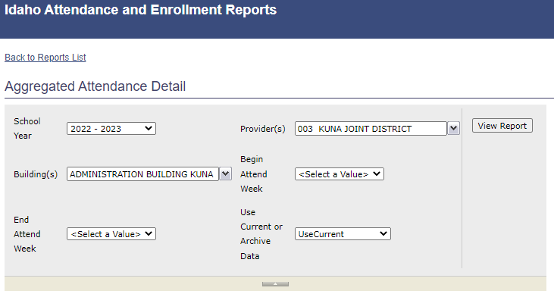
Student Daily Attendance
Notes:
From the various reports, choose the one titled Aggregate Attendance Detail. Like with all reports you’ll need to select certain report parameters. You’ll also want to export the report as an Excel or PDF file.

Slide 15
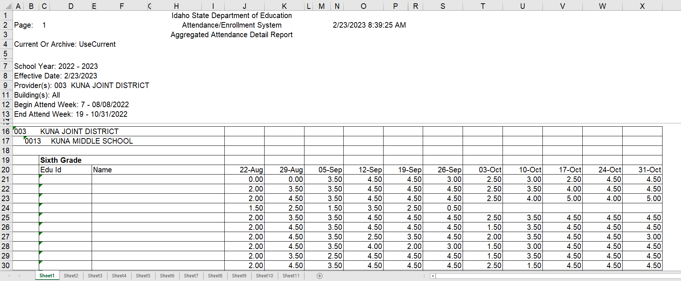
Student Daily Attendance
Notes:
This is how the report looks exported to Excel. Again, the bigger the you are, likely the more sheets you’ll see. Each sheet reports individual student attendance detail within a building (here names and Eduids are hidden). The dates are the Mondays beginning each week. We suggest this review be done by someone in each building familiar with students and their attendance. Initially, look for zeros or blanks. A zero means the student was enrolled, but didn’t have a recorded attendance value that week. A blank means the student was not enrolled during that week. Later, attention can be paid to low values if desired.

Slide 16
Attendance Summary
Uploading attendance is not going away
Attendance is recorded as a daily student value, either 0, ½, 1, or hours
Use the Enrollment Building Level report to verify calendar (days in session by week)
Use the Aggregate Attendance Detail report to verify student attendance (attendance values by week)
Notes:
Please take away these attendance highpoints. Reporting attendance is not going away. It is recorded as a daily student value, either as 0, ½, 1, or hours. After uploading please use the Enrollment Building Level report to verify the days in session by week are accurate. Additionally, use the Aggregate Attendance Detail report to validate student attendance.

Slide 17
Enrollment
Full-Time Equivalent Enrollment (FTE-Enrollment) is the basis of funding this year
  IDAPA 08.02.01.250.04 (temporary Board Rule)
  Average daily attendance (ADA) will be reported by averaging the full-time equivalent enrollment by week for students receiving instruction. To be considered as a student receiving instruction the student must have regular contact with the applicable instructional or pupil service staff member and be completing assignments as applicable to the grade range and course the student is enrolled in. For funding purposes full-time equivalent enrollment in an alternative summer school program shall be based on the student attending 225 (two hundred twenty-five) hours or more or the proportional share of hours up to one (1) average day of attendance.
Notes:
Temporary Board Rule makes Full-Time Equivalent Enrollment (FTE-Enrollment) the basis for funding this year. Essentially, it alters the definition of Average Daily Attendance (ADA) from strictly using Attendance Values to now using what is called an FTE-Enrollment value to calculate ADA. An FTE-Enrollment value from zero to 1 is calculated for every student everyday they are enrolled.

Slide 18
Enrollment
How is an FTE-Enrollment value calculated?
Student has attendance within the prior 10 school days?
True
False
FTE-Enrollment = Minutes per Week (MPW) ÷ 1200
(≤ 1.0)
FTE-Enrollment =
0
Notes:
Here is a diagram of how each FTE-Enrollment value is calculated on any given day. If the student has had any amount of attendance within the prior 10 school days then their enrolled course minutes per week are totaled and divided by 1200 (1200 minutes is the established benchmark for full-time). The FTE-Enrollment value is limited to 1.0. If the student had no amount of attendance within the prior 10 school days then FTE-Enrollment value is zero.

Slide 19
Enrollment
Critical to review
  Accuracy of course minutes
  Course start and end dates
  Student entry and exit dates
  Attendance
Notes:
Therefore, it is critical to review the accuracy of each course’s assigned minutes per week, the course start and end dates, and student entry and exit dates, and as previously mentioned - review attendance since it is a factor in determining FTE-Enrollment values.

Slide 20
Enrollment
How is an ADA based on FTE-Enrollment calculated?
FTE-Enrollment
Student has attendance within the prior 10 school days?
True
False
FTE-Enrollment = MPW ÷ 1200
(≤ 1.0)
FTE-Enrollment = 0
ADA
Aggregate FTE-Enrollment values
Aggregate FTE-Enrollment ÷ School Days
Notes:
This diagram captures how ADA based on FTE-Enrollment is calculated. Within grade groupings all student FTE-Enrollment values are totaled, then an average is achieved by dividing by school days.

Slide 21
Enrollment
ADA based on FTE-Enrollment is shown per building on the Enrollment Building Level report
Notes:
ADA based on FTE-Enrollment is shown per building on the Enrollment Building Level report we’ve looked at previously. The column headed Aggregate Attendance is really Aggregate FTE-Enrollment (that heading change is suppose to be coming this Spring). ADA is simply each week’s Aggregate divided by the Days in Session.

Slide 22
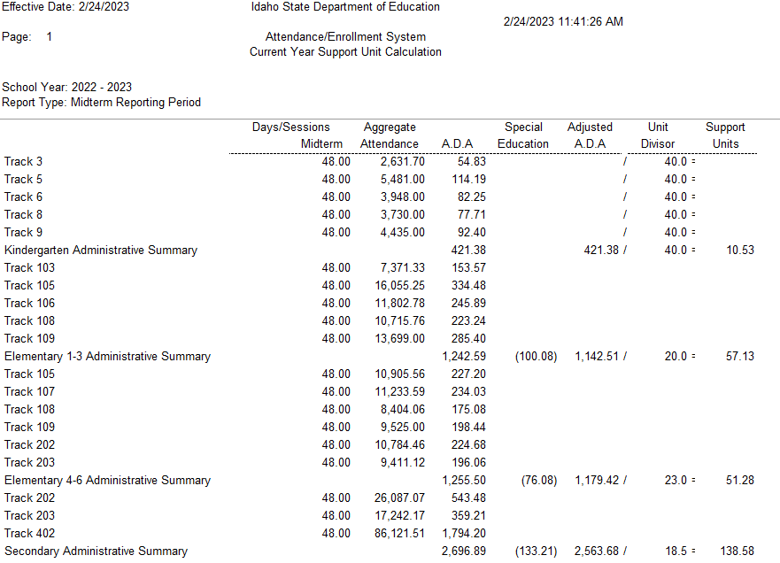
Enrollment
ADA based on FTE-Enrollment is summarized by grade grouping on the Current Year Support Unit Calculation report
Notes:
ADA based on FTE-Enrollment is summarized by grade grouping on the Current Year Support Unit Calculation report. From the reports choose this one and as before you’ll need to select parameters for the report and possibly export it as an Excel or PDF file. Please see the ADA for each of the grade groupings. For the majority, a simple way to check for issues in those ADA numbers is to divide each by the enrollment of grade grouping. For example, as of the first Friday in November this LEA had a kindergarten enrollment of 422. So, 421.38 divided by 422 = 0.999. With Enrollment based funding this ratio generally should be 0.97 or higher.
BTW – the support unit calculation report shows whether you are a “tracked” LEA.

Slide 23
Enrollment
The Current Year Support Unit Calculation report also shows the calculation of the support units
Notes:
This same report also shows the final conversion of ADA into support units. These calculations show the ADA being divided by the appropriate unit divisor from Idaho Code 33-1002(4). The Support Unit Divisor Table is shown on next slide.

Slide 24
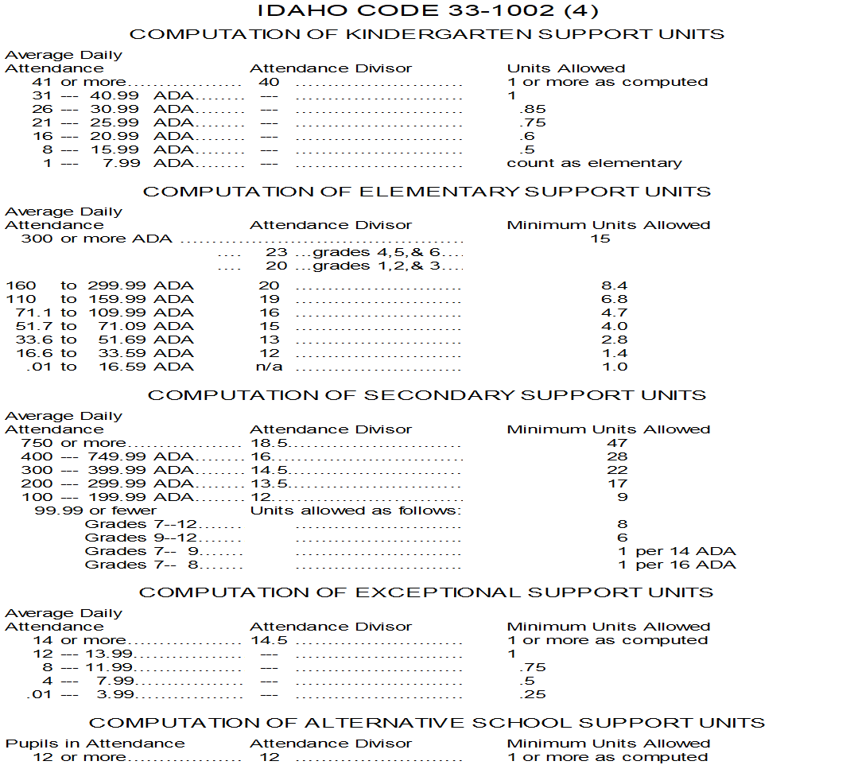
Enrollment
Support Unit Divisor Table
Notes:
Attendance divisors are assigned based on ADA within the 5 grade groupings. Minimum support unit values are built in at lower ADA levels. This helps small LEAs.

Slide 25
Enrollment Summary
FTE-Enrollment value replaces attendance value in ADA based on FTE-Enrollment calculation
Use the Enrollment Building Level report to verify ADA based on FTE-Enrollment against actual enrollment at the building detail
Use the Current Year Support Unit Calculation report to verify ADA based on FTE-Enrollment at the grade grouping level
Use the Current Year Support Unit Calculation report to see support units calculated by divisor
Notes:
These are the enrollment highpoints. FTE-Enrollment values replace attendance values in the ADA based on FTE Enrollment calculation. We suggest using the Enrollment Building Level report to verify the ADA based on FTE-Enrollment against actual enrollment. The Current Year Support Unit Calculation report can be used to verify the ADA based on FTE-Enrollment against actual enrollment at the grade grouping level (ratio 0.97+). This report also shows the grade grouping divisors and the conversion of ADA to support units.

Slide 26
Attendance and Enrollment
Emergency Closures (IC 33-1003A)
  “When a school is closed, or if a school remains open but attendance is significantly reduced because of storm, flood, failure of the heating plant, loss or damage to the school building, quarantine or order of any city, county or state health agency, or for reason believed by the board of trustees to be in the best interest for the health, safety or welfare of the pupils…” the ADA shall be considered as being the same as for the days when the school was open.
Not recognized as an Emergency Closure:
  Insufficient staffing due to a labor dispute
  State athletic tournaments
  Construction delays
Notes:
When you have an emergency closure, weather, facility failure, and wide-spread sickness are causes specified in Idaho Code 33-1003A, please notify me within 72 hours. Certain causes are not recognized as an emergency closure – insufficient staffing because of a labor dispute, athletic tournaments, and construction delays.

Slide 27
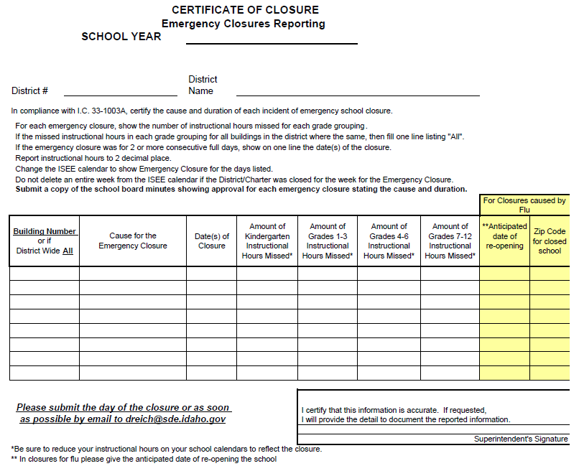
Attendance and Enrollment
Link on SDE website
Change ISEE calendars
Review instructional hour calendars
Within 72 hours email this form to dreich@sde.Idaho.gov
Email the school board minutes when available
Notes:
This is how the form currently looks, but improvements are planned. There is a link on the State Department of Education website. Remember to make SIS calendar adjustments so the emergency closure days come through when you provide ISEE uploads. Be sure to review instructional hours for Idaho Code required minimums (more from Aaron McCoy). Submit the form to me within 72 hours of the closure and submit school board approval when available.

Slide 28
Attendance and Enrollment
Border Out
A student residing within an Idaho district abutting another state where the board of trustees have determined it is in the student’s best interest to attend school in the neighboring state (33-1403 I.C.).
Border In
A student residing outside Idaho attending an Idaho public school. Tuition must be collected. (33-1403 and 33-1405 I.C.)
Not A Border Student
Any student served within their home district or within another Idaho district
Notes:
This topic may only affect a handful of districts, but we’ve seen possible confusion concerning it play out within the student data. Here are updated descriptions of border student status. A border out student resides within an Idaho district that abuts another state and the district’s board has determined it is the student’s best interest to attend school in the neighboring state. Border out students do not generate ADA. The district contracts with a district within the neighboring state and the Idaho district is eligible to receive funding equal to the cost of the out-of-state tuition. A border in student resides outside Idaho but attends an Idaho public school. Border in students do not generate ADA, instead tuition is to be collected. Lastly, any student served within their home district or within another Idaho district is to be identified as not a border student.

Slide 29
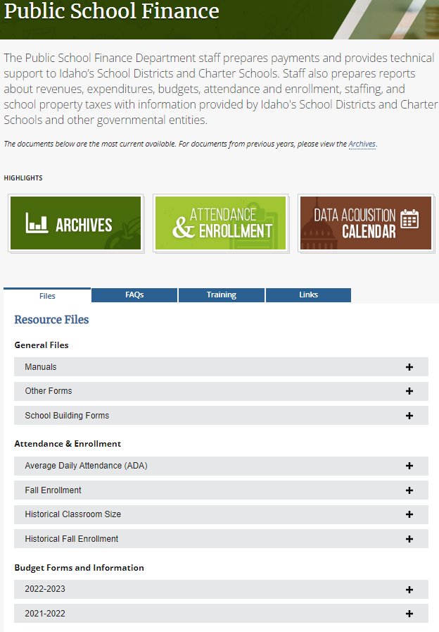
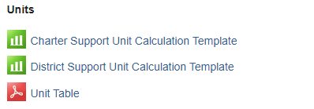
Attendance and Enrollment
Support Unit Budgeting tools https://www.sde.idaho.gov/finance/
Notes:
We do not know what decisions the legislature will make this session, but we will make available support unit calculation tools for the 23-24 school year as soon after session as possible. The current tools are available on the Public School Finance webpage. Go to Budget Forms and Information. You’ll be able to access the coming year templates in a similar manner. Just choose District or Charter depending on who you are.

Slide 30
Contact Me
Dean Reich | Financial Specialist, Sr.
Idaho State Department of Education
650 W State Street, Boise, ID 83702
208.332.6983
dreich@sde.idaho.gov
www.sde.idaho.gov
Notes:
Questions? This is my contact info, please reach out to me I’ll do my best to assist.

